Slide 1

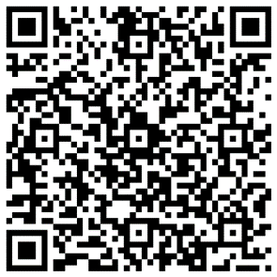

Help shape our digital portal for mental health care
We want to make it as easy as possible for people to see their mental health records and share the right information with the professionals caring for them.
For many people, we can do this securely and conveniently by making better use of digital technology.
We’d like to hear your thoughts on how you might use a Surrey and Borders Partnership digital portal, so that we can build a system designed around your needs.
Please complete our survey, it should take no more than 5 mins:
forms.office.com/e/hpS4z1kizY
Or scan the QR code.
Surrey and Borders Partnership NHS Foundation Trust aims to deliver high quality care across all mental health, learning disability, neurodevelopmental and drug and alcohol support services in Surrey and North East Hampshire.

