Slide 1
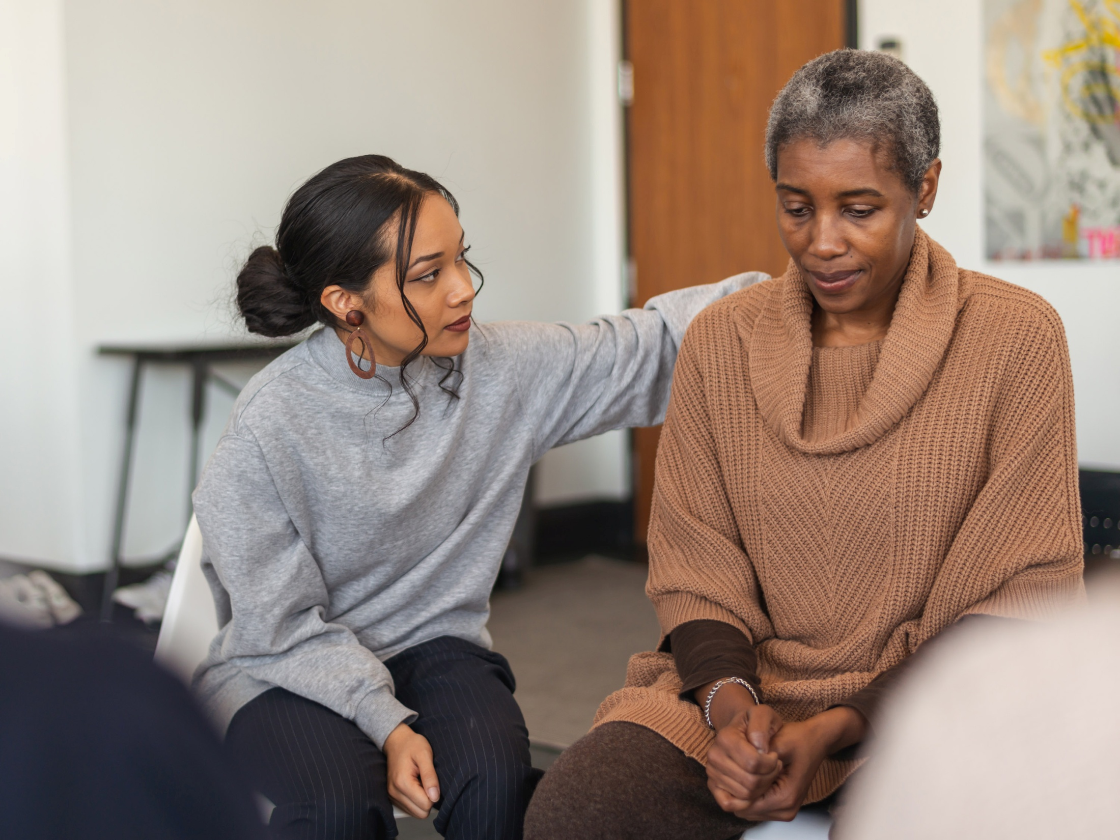

Cancer Personalised Care and Support
Di Riley
Citizen Ambassador Healthwatch Surrey

Slide 2

The NHS Long Term Plan for Cancer states that –
“by 2021, where appropriate, every person diagnosed with cancer will have access to personalised care, including needs assessment, a care plan and health and wellbeing information and support.”
Significant progress has already been made on this front with Cancer Alliances, Integrated Care Systems (ICS), trusts and GP practices working together to offer personalised care interventions.

Slide 3
Cancer Personalised Care and Support
Project Purpose and Aims:
The purpose of this project was to engage with patients who have already been diagnosed with cancer, or their carers to understand their experience of the process.
The aim was to understand what the experience of patients, carers and family members has been like, and to investigate what Personalised Care and Support Services they have found beneficial or may be missing during different stages of the cancer pathway.
  The data collection method was semi-structured interviews chosen as it allowed themes to be explored in-depth while also allowing for participants to raise new themes and ideas
  Interviews were carried out by the Citizen Ambassador for Cancer from Healthwatch Surrey
  The size of the study was limited by the number of participants who agreed to take part

Slide 4
Demographics of those interviewed
Diagnosis
Bowel | 1
Head and Neck | 1
Melanoma | 1
Prostate | 2
Year of diagnosis
2017 | 1
2020 | 2
2021 | 2
.
Stage of disease
Local | 2
Regional | 2
Advanced | 1
Type and Route of Referral/Treatment
1. NHS to Private Practice
2. Private Practice to NHS
3. Screening to NHS
4. GP to NHS
5. Acute Care (NHS) to NHS
Gender
Male | 3
Female | 2
Age
Average age | 64.5
Median age | 64

Slide 5

Findings: aligned to Macmillan 5 core components
1. Everyone diagnosed with cancer has a supportive conversation
Variation in the level of interpretation of what a ‘Supportive Conversation’ is, apart from one participant (predominately treated privately), none felt fully supported.
One participant felt their Cancer Nurse specialist (CNS) never had time for him, and he was ‘in a system’.
Another commented on the number of times they had to repeat their past medical history or medications prescribed, which raised concerns about communication and continuity between the different clinical teams.
There were also comments about not feeling able to talk openly, the processes happening too fast along with not fully understanding exactly what the treatment entailed or how they might feel afterwards.
2. Health and wellbeing information resources are made available during the conversation and throughout a person’s cancer journey
This varied between participants, some were told not to look on the internet, whereas others felt they were given lots of leaflets but did not really get advice on which to look at when.

Slide 6
Findings (Cont’d)
3. The person’s needs are assessed in line with a Holistic Needs Assessment (HNA) approach
None of the participants were asked to complete a ‘concerns checklist or other similar assessment tool to enable their clinical team to understand their holistic needs
Similarly, the majority felt there was no attention to their emotional wellbeing
5. A personalised care and support plan, facilitated by their assessment, is developed with the person living with cancer
None of the participants were given a personalised care and support plan by their hospital clinical teams
There was mixed support from Primary Care provided for the participants, which varied from good support to ‘hopeless’

Slide 7
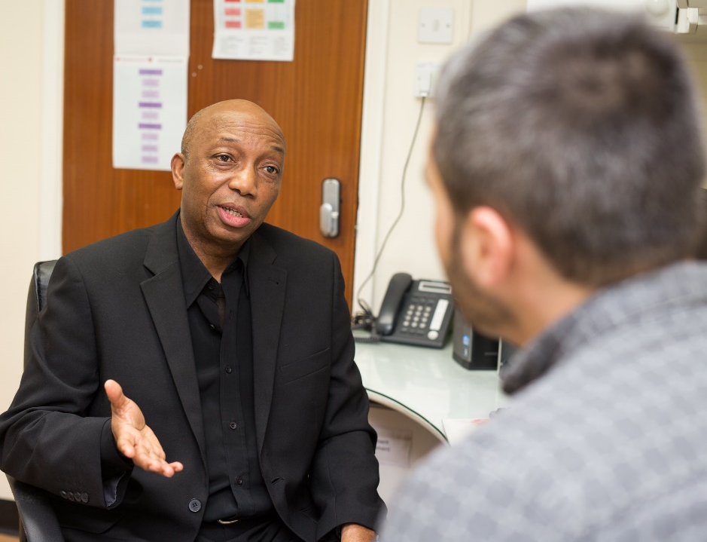
Findings (Cont’d)
5. Every person with cancer can access help by navigating the care and support they need
There were mixed views to this core component, which probably reflects the differing needs of the participants to be in control of their condition. Though it links back to the findings made in point 6.2.
One participant felt they wanted to locate chat rooms and helplines themselves whereas others felt they did not get any help with signposting local support groups.

Slide 8
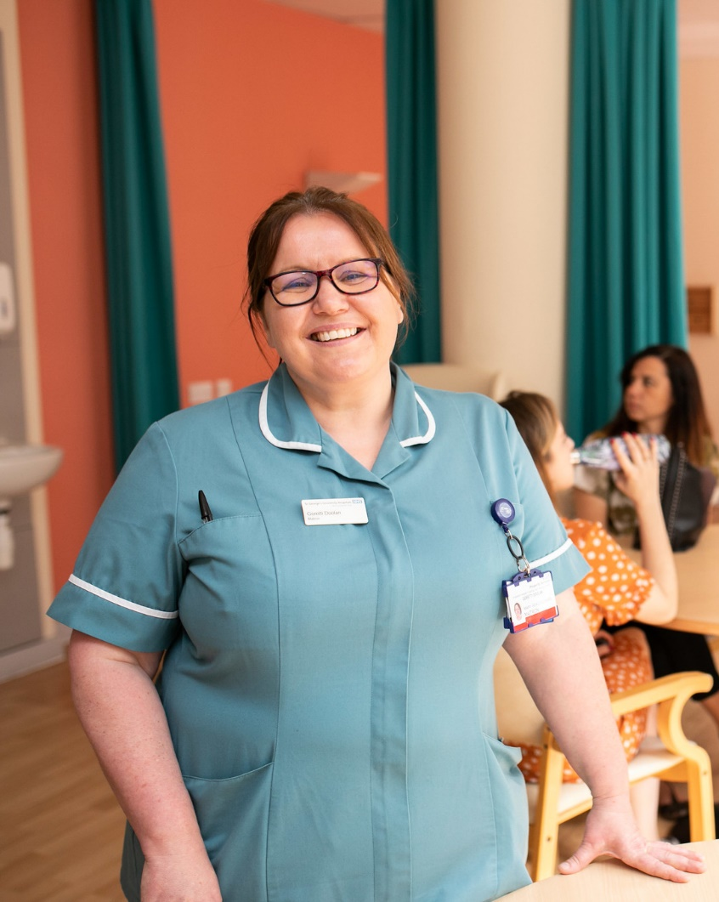
Recommendations
1. All clinical teams are asked to ensure every patient has a holistic needs assessment which is reviewed with the patient and their supporters
2. All clinical teams are asked to ensure every patient has a Personalised Care and Support Plan, which is shared with the patient
3. Whilst it is recognised that resources are stretched across the NHS, clinical teams need to ensure that all patients have access to a Clinical Nurse Specialist (CNS) or other key worker who can coordinate care, respond to concerns, and generally support patients and their supporters, and has the time allocated to do this.

Slide 9
Soundbites
“I felt my care was definitely personal and specific to me….”
“I felt care for, not cared about……”
“I felt invisible, no one told me what was going on…. I felt very frightened……”
“No-one seemed interested in ME….”
“I felt I was in a system…..”
“My cancer controlled me rather than the reverse…….”
“I felt my CNS did not have time for me……”
“Going into follow-up I felt I was falling off a cliff with little support…….”

Slide 10
Soundbites
“It all happened too quickly, no time to think………”
“My clinical team was ‘amazed’ when I told them I struggling emotionally…..”
“I felt I was taking up valuable time of the clinical team…..”
“I now realise the benefits of having a list of questions and taking these with me……”
“One of the hardest parts was telling my family and friends….it would have helped to know how to have this conversation…..”

Slide 11




How to contact Healthwatch Surrey
Telephone: 0303 303 0023 (local rate number)
Text (SMS): 07592 787533
Email: enquiries@healthwatchsurrey.co.uk
Website: www.healthwatchsurrey.co.uk
/HealthwatchSurrey
@HW_Surrey
healthwatch_surrey
Healthwatch Surrey

