Slide 1
Integrated Sexual Health and HIV Services in Surrey
Patient Information and Discussion Event
Saturday 9th September
10.30 - 12

Slide 2
Agenda
Welcomes and Introductions
Steve Emerton NHS England South | An introduction
Surrey County Council and NHS England | Background
Purpose of the meeting Provide information about future services for Sexual Health, HIV and patients with other genital conditions including pain and skin conditions Listen and answer questions Provide information about commissioning of the services.
Ashford and St Peter’s Hospitals NHS Foundation Trust | Current services and work on transition
Central and North West London NHS Foundation Trust | The New Service
Surrey County Council and NHS England South | Integrated Sexual Health and HIV Services in Surrey
Discussion

Slide 3
Background 1
Expiry of contracts with ASPH and other providers to provide services at BHU and elsewhere – 31 March 2017.
Legal obligations on SCC and NHSE to formally procure replacement services.
Sexual health needs assessment, patient survey etc incorporated into development of service specification for replacement services used in procurement.
Procurement exercise (May – September 2016)
Contract awarded to CNWL on 29 September 2016. ASPH and other providers elected not to bid.
CNWL bid based on estate made available to it during the tender process, which did not include the BHU or St Peter’s Hospital.

Slide 4
Background 2
Mobilisation of new contract with CNWL began in November 2016.
Phase 1 – transfer of staff and patients from Virgin Care to CNWL (took place from 1 April 2017).
Phase 2 – transfer of staff and patients from Frimley to CNWL (took place from 30 June 2017 following 3 month extension to contract).
Phase 3 – transfer of staff and patients from ASPH to CNWL (will take place from 1 October 2017, following 6 month extension to contract with ASPH).

Slide 5
Work to date
Operational meetings in place with senior clinical leads at CNWL and ASPH to work through all mobilisation.
Mobilisation meetings with commissioners and CNWL to ensure safe transition.
CNWL Transitional Clinic at St Peters for patients with HIV.
Patient Users Working group to be set up to work with us to ensure mobilisation is effective and addresses patient needs.
Patients with other genital conditions including pain and skin conditions will remain with ASPH.

Slide 6
Ashford and St Peter’s Hospitals NHS Foundation Trust
Tom Smerdon – Director of Operations

Slide 7
Achieving Clarity
We know there are different patient groups using BHU that need to be catered for:
  Walk-in sexual health service patients
  HIV patients with a range of abnormalities and complexity
  Patients with other genital conditions including pain and skin conditions
The care needs of the first two groups will transfer to CNWL on 1 October and will have their needs met through CNLW’s model of care.
The third group of patients will continue to have their care coordinated by ASPH, most likely on the St Peter’s site. We will work in partnership with those patients and with the local commissioner to define those care pathway and service delivery models
In addition to patients there are other important stakeholders; carers, GPs and the Blanche Heriot Team
The Blanche Heriot Unit and the Service are not the same thing:
  The Unit is currently the location from which a great deal of the service has been coordinated and delivered
  A change in service provider is not the same as closing the unit, because the service is going to be re-provided in a new way
The service locations are important to patients and we are committed to working with CNWL and others to ensure access is enabled

Slide 8
Moving Forward
We pledge to involve those patients who will remain with ASPH in designing and delivering a new model of care, Dr Pritchard has committed to support us with this work
We pledge to carry out an individual clinical review of patients with complex needs to ensure their needs are met and are managed appropriately, in line with best practice
We will work closely with CNWL and support them to mobilise the service they have been commissioned to provide. This is the responsible way to act for patients
We will approach the planning and delivery of the transition in line with our Trust values/4 Ps.
We will cherish and safeguard the values of the Blanche Heriot Unit services and pledge to embed the philosophy in future service to be delivered at SPH
We will value and take care of BHU team members and work with CNWL to safeguard their well being through this transition.

Slide 9
How we've responded to the Issues you've raised
Clear information on the residual services for vulval pain and genital dermatology; how we will manage these and how these will be commissioned?
  The residual services will be incorporated into the Gynae team, Dr Pritchard will remain a member of Staff at ASPH and will continue to provide the service.
  Commissioning arrangements are being discussed
Clear information on the transitional services for HIV and complex patients; how that will work and for how long.
  The transitional service for HIV patients will run for six months from 1st October at ASPH. Every patient will be offered an appointment.
Communication we have had with patients
  HIV patients
  Residual Service Patients
  Sexual Health Patients

Slide 10

Integrated
Sexual Health and HIV Services
Dr Simon Edwards - Clinical Director
Mark Maguire - Service Director

Slide 11
Introduction
Improving Health and Wellbeing and Health Promotion
Services in Surrey
Patient Engagement and Feedback
Patient Website
Freedoms Shop
Coming soon…
Follow-up care in the new service
Partnerships
Questions

Slide 12
Introduction
CNWL is the largest community NHS Trust and one of the largest providers of Sexual Health services in England
Each year we see:
  120,000 Sexual Health patients
  4,600 HIV patients
  500 Hepatitis patients
Teaching Trust working closely with University College London, providing education and training to healthcare professionals, including GPs
Integrated services - GUM and Contraception in 1 appointment, where possible
Health Promotion to vulnerable and ‘at risk’ groups
Dedicated Adults and Children Safeguarding Team
Rated “Outstanding” by the Care Quality Commission (CQC)

Slide 13
Improving Health and Wellbeing
Open Access
Greater focus on prevention, self-care, and targeting ‘at risk’
Diagnosing, treating and preventing STIs
Improving choice of contraception
Increasing LARC (Long Acting Reversible Contraception)
Reducing unwanted pregnancies
Reducing repeat abortions
Increasing HIV testing
Preventing late diagnosis of HIV
Partnerships to improve wider social determinants of health
Notes:
Public Health Outcomes Framework:
Under 18 conceptions
Chlamydia diagnoses (15-24 year olds)
People presenting with HIV at a late stage of infection

Slide 14
Services in Surrey
Three main Clinical Hubs
Buryfields (Guildford) – GUM, Contraception, HIV (main site)
Earnsdale (Redhill ) – GUM, Contraception, HIV
Woking Contraception – GUM, Contraception
Additional Clinical Sessions
Leatherhead Hospital: Mondays and Fridays, 10:00 am to 12:30 pm (Improving access for young mothers)
Epsom Clinic: Mondays 4:00 pm to 7:00 pm and Wednesdays 3:00 pm to 7:00 pm (improving access for young people)
Spelthorne and Runnymede: Working with local GPs to agree sites
Notes:
Spoke Clinical Outreach Sessions
‘Clinic in a Box’
Education and support
Non-complex contraception (implants, pills, Emergency Contraception)
Pregnancy Testing
Chlamydia/Gonorrhoea screening
HIV testing - available in September
C-Card Condom Distribution
Bookings for LARC and full STI screening in Hubs

Slide 15
Services in Surrey
HIV Treatment and Care (outpatients)
Assessment and treatment – Anti Retroviral Drugs (ARVs)
Support for those with co-morbidities, e.g. Hepatitis
Home Delivery or Clinic Delivery of ARVs
Dedicated Pharmacy support
Transitional HIV Clinic at St Peter’s Hospital
Support transfer of complex and vulnerable patients to CNWL services
1 session a week for 6-9 months
HIV advice for healthcare professionals
Available by dedicated email and telephone during clinic hours
9am to 7pm Monday to Thursday and 9am to 4pm on Friday
Notes:
Target Clinical Outreach and ‘at risk’ groups
Young people under 25
BME communities
Sex Workers
MSM / ChemSex
People with disabilities
Trans communities

Slide 16
Online STI Screening Service
Increased access throughout the County
Health Promotion Outreach/Prevention
Working with partners in community settings targeting vulnerable groups and those ‘at risk’
Health promotion, prevention and self-care
Condom Distribution
Chlamydia and Gonorrhoea screening for Under 25s
Sexual Health and HIV services in Surrey Prisons

Slide 17
Patient Engagement and Feedback
Patient Engagement
Service developments
User groups
Surveys (Survey Monkey, Mobile App)
Focus Groups
Patient Feedback
Quarterly Surveys (including NHS Friends and Family Test)
  During the period from April to June 2017, 90% of patients said they were likely or extremely likely to recommend our services to others
Comments cards
Complaints and compliments

Slide 18
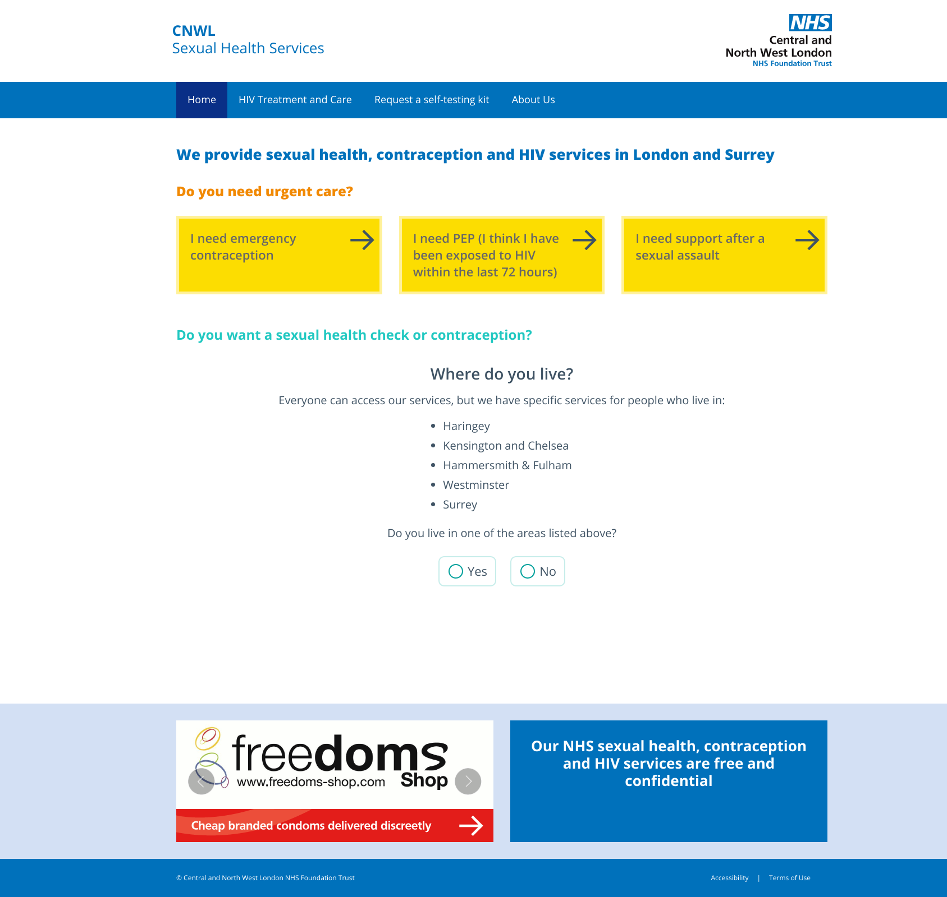
Patient Website
sexualhealth.cnwl.nhs.uk

Slide 19
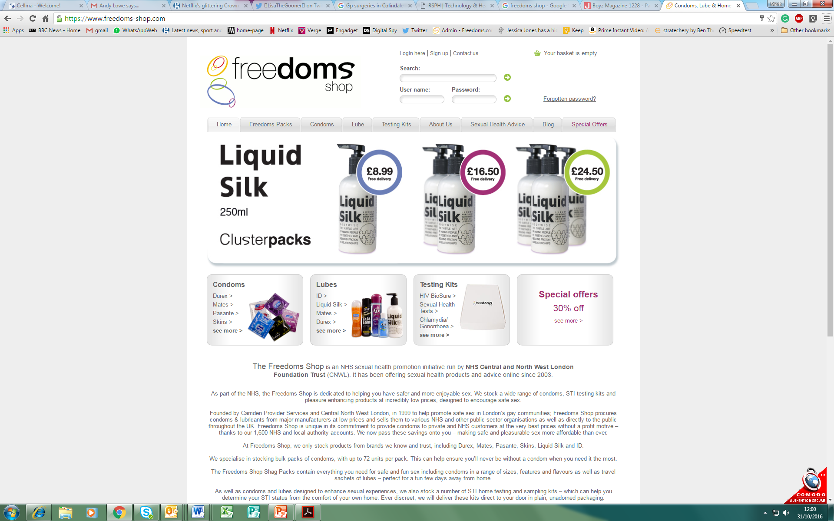
Freedoms Shop - low cost condoms/lube
Freedoms Shop is an NHS Sexual Health Promotion initiative
https://www.freedoms-shop.com/

Slide 20
Coming soon…
New Mobile App
Online services:
  Register with the service
  Book an appointment
  Order Home Screening Kits (delivered to your home or a Hub Clinic)
  Collect test results
More self-care support, information, advice and videos
More dual trained staff (GUM/Contraception) so where possible more care be provided in one appointment

Slide 21
Coming soon…
  Buryfields Clinic (Guildford) - every Saturday
  Young People Saturday clinics – alternate weeks at Woking Clinic and Earnsdale Clinic (Redhill)
More community Clinical Outreach sessions with Nurses and Doctors offering a wider choice of contraception (LARC) and STI/HIV screening
More support for General Practice and Pharmacies to and easy access to clinical advice
Notes:
Surrey Prisons:
HMP Bronzefield – female (527)
HMP Coldingley – male (513)
HMP Downview – female (355, potentially increasing to 455)
HMP High Down – male (1,200)
HMP Send – female (282)

Slide 22
Follow-up care in the new service
Sexual Health and Contraception Patients
We will contact all patients who have a booked follow-up appointment and/or are expecting a test result
We will make sure the appointment goes ahead and provide test results and any follow-up care that is needed
HIV Patients
We will contact patients who choose to transfer their care to CNWL so we can discuss their needs in more detail
We will let patients know what services we offer, including options for getting blood tests and delivery of ARVs
HIV Transition Clinic at St Peter’s Hospital for 6-9 months

Slide 23
Partnerships
Hospital services - including clear referral pathways to specialty services (including pelvic pain and dermatology)
General Practice
Pharmacies
Healthy Schools Programme – Sex and Relationships Education
School Nurses
Young Peoples services
Third Sector and local groups
Safeguarding
Sexual Assault services

Slide 24
Dr Simon Edwards - Clinical Director
020 3317 5225
Mark Maguire - Service Director
020 7685 5945
sexualhealth.cnwl@nhs.net

Slide 25

Questions

Slide 26

Integrated Sexual Health and HIV Services in Surrey
Lisa Andrews, Surrey County Council
Fiona Mackison, NHS England South

Slide 27
Sexual Health Needs Assessment:
Key Messages
Runnymede and Spelthorne - higher than the national average rates of teenage conceptions
Over 60% of teenage conceptions result in termination
Woking - higher than the national rate of HIV
Adults and young people wanted better access to services
Sexual health services could be promoted more effectively
To improve patient experience by ensuring pathways are joined up
Variations in service provision across the county.
  Resources could be more effectively targeted to needs.
Integration of services to allow needs to be met holistically.

Slide 28
Sexual Health Needs Assessment: Recommendations
Relationship and Sex Education (RSE)
School Nurse role
Missing out on education
Positive relationships
Further education/ colleges/ universities
Termination of Pregnancy
Young Parents
Looked After Children
Services for under 25s
Patient Choice
Pharmoutcomes
HIV

Slide 29
Interdependencies
Antenatal and post natal services
Cervical Screening Programme
Child and adolescent mental health services
Colorectal
Community pharmacy
Dermatology
Drug, alcohol, obesity and smoking intervention services
General practice
Gynaecology
Male and female sterilisation services
Mental health services
Other healthcare service areas including voluntary sector
Pathology and laboratory services
Prisons and youth offenders institutions
School and education services including further education and university
Sexual Assault Referral Centre
Social Care
Termination of pregnancy providers
Youth services
Community Health Services including school nursing and health visiting
Maternity
Domestic abuse outreach services – refer to NICE guidance
Notes:
Specifically, linkages will be maintained with, GPs, community pharmacy, wider Local Authority services, Health Promotion, other sexual health and secondary health service providers for use when relevant.
The Service cannot work in isolation and is required to work with partners to address the needs of service users and increase the opportunity for service users to achieve optimum sexual health outcomes.

Slide 30
Quality and performance monitoring
Sexual health contract:
Quality outcome indicator | No of KPIs
Clinical management | 13
Improving productivity | 6
Under 25s services | 5
Service user experience | 3
Quality outcomes | 2
Reducing inequalities | 8
Access | 9
Public health outcomes framework:
Under 18 conceptions | Rate of conceptions per 1000 of under 18 pop
Chlamydia diagnosis | Chlamydia infections in 15-24 pop per 100,000
HIV- late presentation | Percentage of adults (aged 15 or above) newly diagnosed with HIV with a CD4 count less than 350 cells per mm³
Notes:
CNWL will perform against the service specification and the information detailed in the Sexual Health Needs Assessment. They have clear performance metrics in the contract and we have an obligation to deliver on the Public Health Outcomes Framework.
Joint quarterly contract meetings with NHSE and CNWL.
Performance of the contract will be monitored through a series of key performance indicators (KPIs) as detailed in the specification and reviewed at quarterly meeetings.
A number of KPIs are set nationally by the department of health and these are in line with the public health outcome framework and others are set locally to relect local prioties as determined by the needs asessment.

Slide 31
Quality and performance monitoring
HIV treatment and care contract:
NHS England have agreed a suite of metrics to monitor performance which will include:
  Prescribing
  Patient experience
  HIV testing (offered, tested, new diagnosis)

Slide 32
Contact details
Surrey County Council
Lisa Andrews, Senior Public Health Lead
email: public.health@surreycc.gov.uk
NHS England
Fiona Mackison, Service Specialist
email: england.speccomm-south@nhs.net

Slide 33
Questions and discussion

Slide 34
Purpose
To share information on sexual health and HIV services in Surrey and provide an opportunity for discussion.
Contents
Commissioning responsibilities
Re-commissioning process
  Sexual health needs
  Budget
  National guidance
CNWL – the new service model

Slide 35
Commissioning responsibilities
Local authority | NHS England | CCGs
Contraception STI testing and treatment Psychosexual counselling Targeted outreach | HIV treatment and care Prison SARC Cervical screening | Termination of pregnancy services Contraception for non-contraceptive purposes
Notes:
In 2013, the responsibility for arranging the provision of certain sexual health services transferred to Local Authorities. This includes:
Contraception (including the costs of Long Acting Reversible Contraceptive devices and prescription or supply of other methods including condoms) and advice on preventing unintended pregnancy, in specialist services and those commissioned from primary care (GP and community pharmacy) under local public health contracts (PHAs)
Sexually transmitted infection (STI) testing and treatment in specialist services and those commissioned from primary care under local public health contracts, chlamydia screening as part of the National Chlamydia Screening Programme (NCSP), HIV testing including population screening in primary care and general medical settings, partner notification for STIs and HIV.
Sexual health aspects of psychosexual counselling
Any sexual health specialist services, including young people’s sexual health services, outreach,
HIV prevention and sexual health promotion, service publicity, services in schools, colleges and pharmacies
NHS England (NHSE) hold responsibility for commissioning:
Contraceptive services provided as an ”additional service” under the GP contract
HIV treatment and care services for adults and children, and cost of all antiretroviral treatment. CNWL are contracted to provide HIV care for Adults. Paediatrics are served by London providers.
Testing and treatment for STIs (including HIV testing) in general practice when clinically indicated or requested by individual patients, where provided as part of “essential services” under the GP contract (ie not part of public health commissioned services, but relating to the individual’s care)
HIV testing when clinically indicated in other NHS England-commissioned services
All sexual health elements of healthcare in secure and detained settings
Sexual assault referral centres
Cervical screening in a range of settings
HPV immunisation programme
Specialist fetal medicine services, including late surgical termination of pregnancy for fetal anomaly
NHS Infectious Diseases in Pregnancy Screening
Commissioning Groups are responsible for commissioning:
Abortion services, including STI and HIV testing and contraception provided as part of the abortion pathway
Female and male sterilisation
Non-sexual health elements of psychosexual health services
Contraception primarily for gynaecological (non-contraceptive) purposes
HIV testing when clinically indicated in CCG-commissioned services (including A&E and other hospital departments)

Slide 36
Re-commissioning of sexual health services in Surrey
December 2015: Recommissioning process of sexual service began
April 1st 2017: Service went live
Drivers:
  end of the contract with the main sexual health provider in Surrey on 31st March 2017
  the need to consolidate and reconfigure existing services to meet need
  the reduction in the public health grant
  national guidance
Notes:
Previous service provision-
Virgin Care Ltd
Frimley Park Hospital
Ashford St Peters Hospital
Decision to go to tender
With the ending of the Virgin Care Community contract in March 2017, Surrey County Council was legally bound to carry out a full tender process, compliant with EU Public Contract Regulations and the Council’s Procurement Standing Orders. This included advertising the contract opportunity in the Official Journal of the European Union.

Slide 37
Sexual Health Needs Assessment
Underpins the procurement
Provides data from a variety of sources including perspectives of clinicians and service users
Includes intelligence on:
  Under 16s
  16-24 year olds
  Over 25s
  Key population groups eg:
    Sex workers
    People with disabilities
    LGBT
    BME
    Older people (50+)
    Mental health
    Men who have sex with men

Slide 38
Budget
Surrey Public Health budget:
  below-target funding
  national cuts to the Public Health grant
2015/16 to 2019 - decrease of 30% to the overall public health budget
NHS England expect no reduction to the budget.
The financial envelope available for this procurement reflected this but still allows:
  a quality service
  in-line with national requirements
  responsive to local needs
Notes:
The contract value is £4,333,000 per year. Total of £21.7 for the lifetime of the contract (5 years including a 2 year extension)
4 million is the sexual health tariff and 333 per year for the outreach element on a block basis

Slide 39

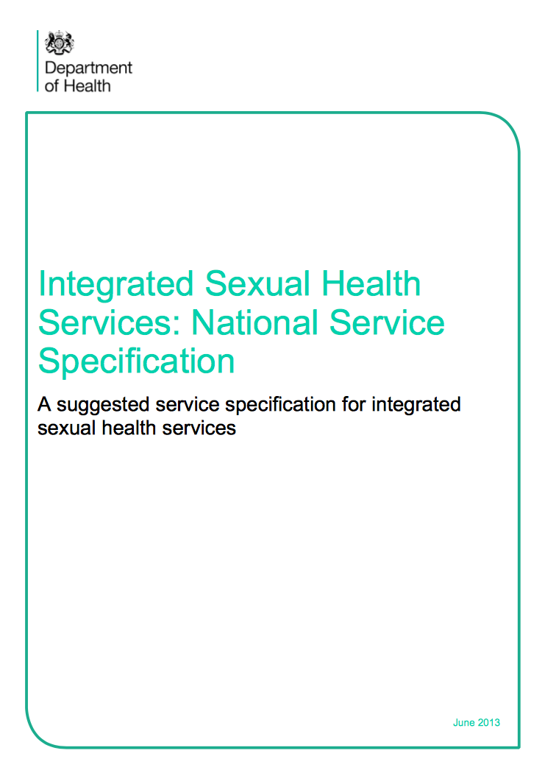

National Guidance
Notes:
The contract value is £4,333,000 per year. Total of £21.7 for the lifetime of the contract (5 years including a 2 year extension)
4 million is the sexual health tariff and 333 per year for the outreach element on a block basis
HIV details?

Slide 40
Integrated Services
An integrated sexual health and HIV service aims to:
An integrated sexual health and HIV service includes:
improve sexual health by providing easy access to services through open access ‘one stop shops’
where the majority of sexual health and contraceptive needs can be met at
one site, usually by one health professional
in services with extended opening hours and accessible locations.
Contraception (including LARC)
STI Testing and Treatment
Psychosexual Counselling
HIV Prevention
Young People’s Sexual Health and Teenage Pregnancy
Sexual Health Promotion
Chlamydia screening
HIV treatment and care based on national guidance
Notes:
The provision of integrated sexual health services is supported by current accredited training programmes and guidance from relevant professional bodies including FSRH, BASHH, BHIVA, MEDFASH, RCOG and NICE
al service specification for integrated sexual health services. We have used this as the template for our local service specification and added in local need.

Slide 41
Discussion

Slide 42
Patient engagement
Hosting another Patient Information and Discussion Event on Saturday 9 September at 10.30 am - 12.00 pm, Room 3, Chertsey House, St Peter’s Hospital.
Hosting a webinar on 13 September from 12.00 pm till 1.30 pm for those unable to attend the Patient Information and Discussion Events Register for this webinar here.
Developed an online survey for past/current service users of the Blanche Heriot Unit to share their views https://www.engage.england.nhs.uk/survey/009611c3/

