Slide 1






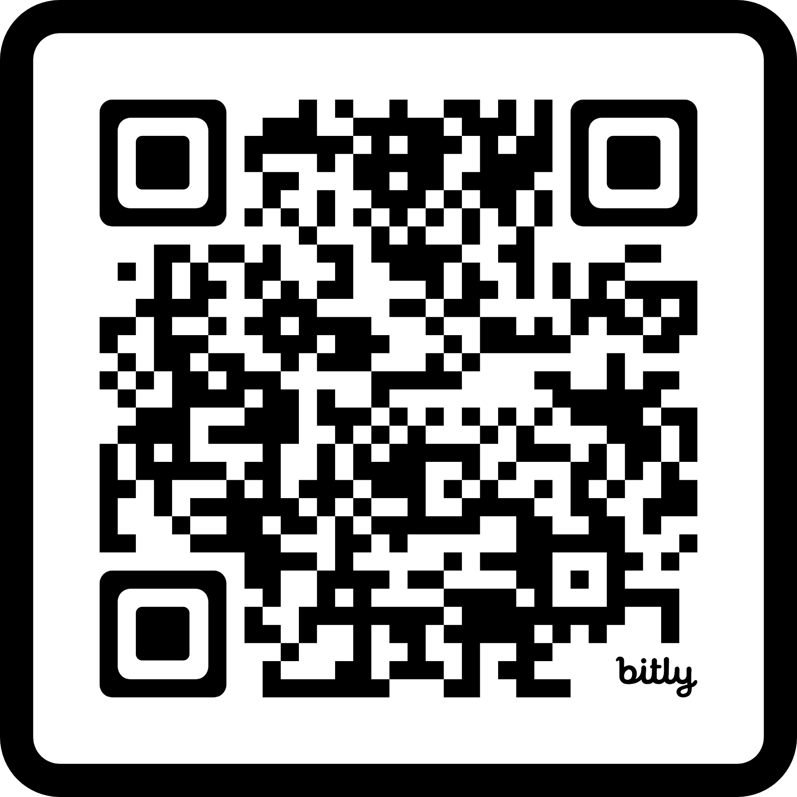
Adult Social Care Occupational Therapy (OT) Practice Evaluation
Join our User Reference Group
To support delivery of a research project evaluating
Occupational Therapy services at the front door of Adult Social Care
Who Can Join?
Adult Social Care clients and carers with experience of OT services
Our commitment to you
A £45 thank you voucher per session attended
Accessibility arrangements including travel, wheelchair access and interpretation
Your commitment to us
Attendance at three, 90 minute meetings held online or in person
Active contribution to the design and delivery of the research project
Attendance at one, 2 hour in person event to share findings
To find out more contact us or use the QR code to register your interest
Bronia Woodhouse, Practice Lead Bronia.woodhouse@surreycc.gov.uk
07967677391
Chay Roofe, Researcher
Chay.roofe@surreycc.gov.uk
01737 737504

